Slide 1
Mine Action in the Humanitarian Cluster System
Prepared by UNMAS Geneva Office
August 2023

Slide 2

Contents
Inter-Agency Standing Committee
Mine Action in the Humanitarian Cluster System
Global Protection Cluster
IASC Reference Module for Cluster Coordination
Mine Action Area of Responsibility (Functions, Network, Mission, Work, Governance)
GPC Strategic Framework 2020-24
Members of the MA AoR
Humanitarian Needs Overviews and Response Plans
MA in HRPs in 2021, 2022, 2023
MA AoR Strategy
GPC Website: Mine Action AoR

Slide 3
Inter-Agency Standing Committee (IASC)
Created by United Nations General Assembly resolution 46/182 in 1991, the Inter-Agency Standing Committee (IASC) is the longest-standing humanitarian coordination forum of the United Nations system. It brings together the executive heads of 18 organizations to formulate policy, set strategic priorities and mobilize resources in response to humanitarian crises.
The IASC strengthens collective humanitarian action through the implementation of a coherent, unified response. It advocates for common humanitarian principles and makes strategic, policy and operational decisions with a direct bearing on humanitarian operations on the ground.
The IASC is chaired by the Emergency Relief Coordinator (ERC) who brings critical issues to the attention of the United Nations Secretary-General and Security Council.
The IASC established the cluster system where agencies have clear responsibilities for coordination of specific sectors. UNHCR leads the Global Protection Cluster (GPC) and UNMAS leads its Mine Action Area of Responsibility.

Slide 4
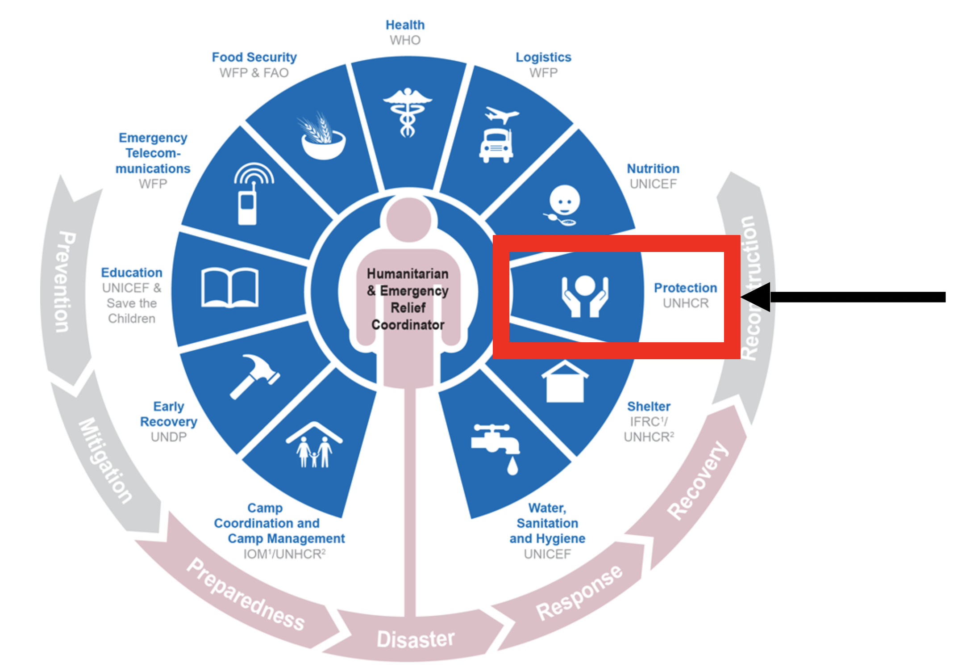


Mine Action in Humanitarian Cluster System

Slide 5

IASC Reference Module for Cluster Coordination
Cluster and Sector Coordination
Cluster Activation
Cluster Functions
The Role of Clusters in Preparedness
Cluster Management Arrangements
Sharing Leadership
Minimum Commitments for Participation in Clusters
Inter-Cluster Coordination, Sub-National Coordination, Monitoring Cluster Coordination

Slide 6


Cluster/AoR: Six Core Functions
1
Support service delivery
Inform the Humanitarian Coordinator/Humanitarian Country team’s strategic decision-making
Plan and implement cluster strategies
4
Monitor and evaluate performance
Build national capacity in preparedness and contingency planning
Support robust advocacy
2
5
3
6

Slide 7


Network of NGOs, IOs, and UN agencies engaged in protection work in humanitarian crises, including armed conflict
Work: coordinate the development of policy, standards and operational tools relating to protection in humanitarian action, including
practical guidance on how to establish
and manage protection
coordination mechanisms
Mission: ensure (i) well-coordinated,
effective and principled protection
preparedness and responses and (ii)
protection is at the core of humanitarian action and considered essential for development and peace
Governance:
Strategic Advisory Group

Slide 8
GPC Strategic Framework 2020-24
Establish basics of protection coordination in all our operations
Ensure voices of crisis-affected persons are heard, esp. the forgotten ones
Make protection contextually appropriate and complementary
Champion durable solutions through a nexus of humanitarian, peace and development action
Adapt to the shifting operational environment and keep looking forward

Slide 9


MA Area of Responsibility
MA AoR: global coordinator for mine action
Lead Agency: UNMAS (Geneva) and NGO co-lead (Danish Refugee Council)
Key functions
Field Support to activated MA AoR
Bring together mine action actors
Representation in policy development
Engaging with humanitarian partners notably OCHA, the Global Protection Cluster (UNHCR) the Child Protection AoR (UNICEF), the Housing, Land and Property AoR (NRC), the Health Cluster, the IOM DTM
Provider of Last Resort

Slide 10
"Provider of Last Resort"
Definition: where necessary, and depending on access, security and availability of funding, the provider of last resort must be ready to ensure the provision of services required to fulfil crucial gaps identified by the cluster and reflected in the HC-led HCT Humanitarian Response Plan

Slide 11

Members of the MA AoR

Slide 12
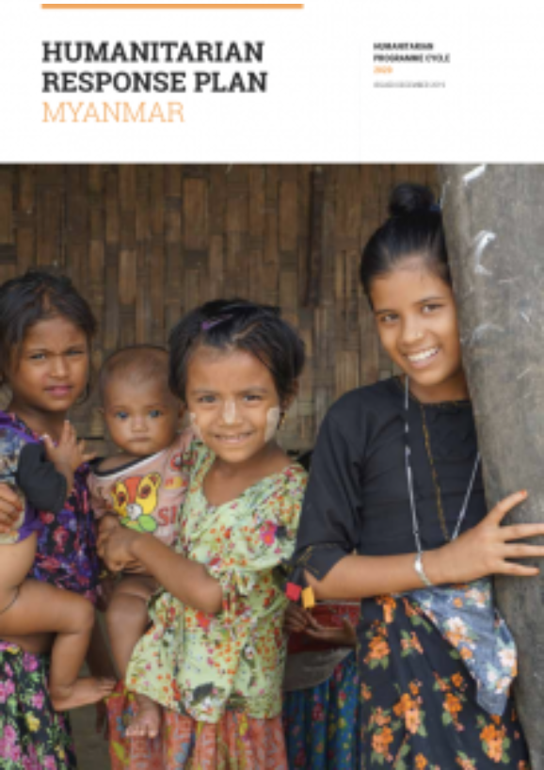

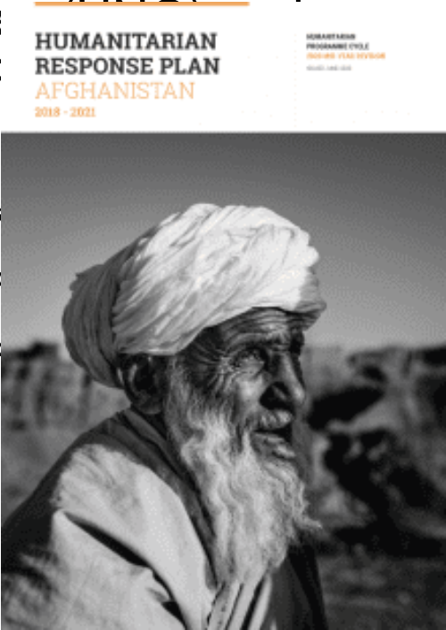
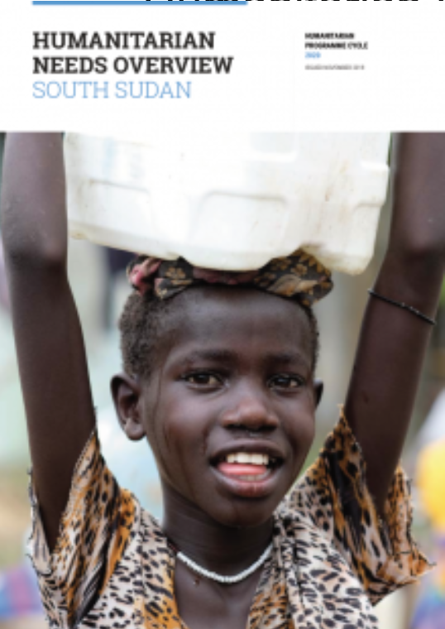
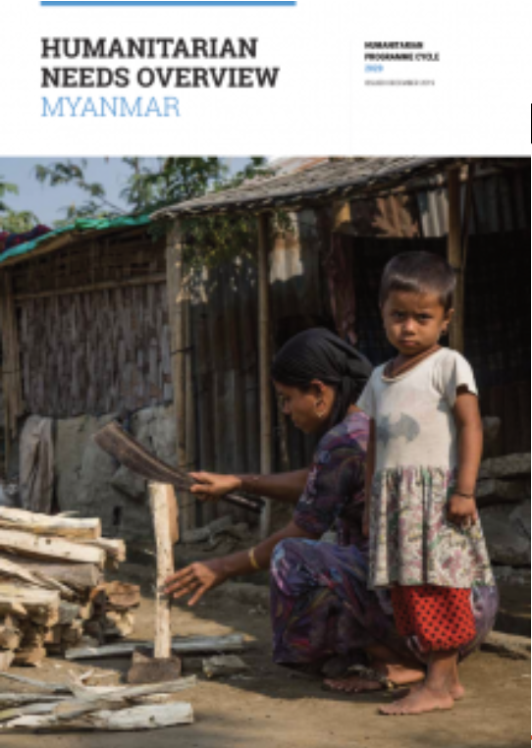
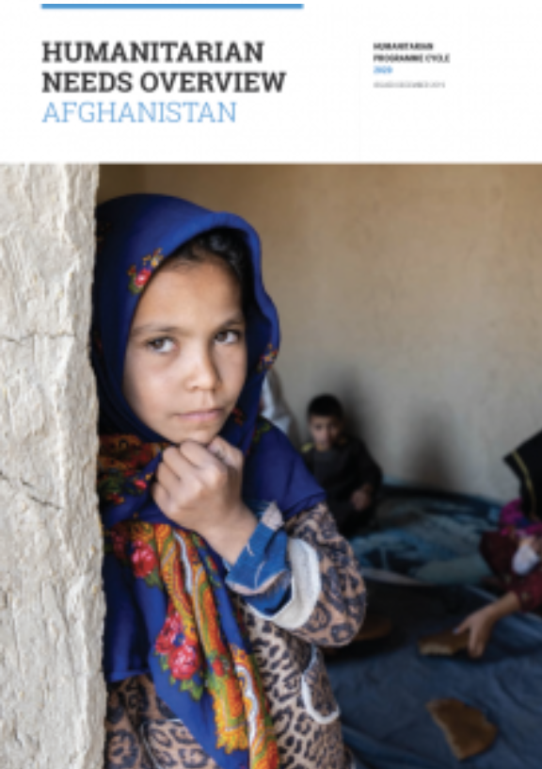
Humanitarian Needs Overview (HNO)
Prepared for protracted or sudden emergencies and provide a shared understanding of the crisis, the most pressing humanitarian needs and the estimated number of people who need assistance (PiN)
MA AoR contributes to the risk analysis
Humanitarian Response Plan (HRP)
Articulate a shared vision by all clusters on how to address the needs of affected people and develops a strategic response plan
MA AoR coordinates the mine action response

Slide 13
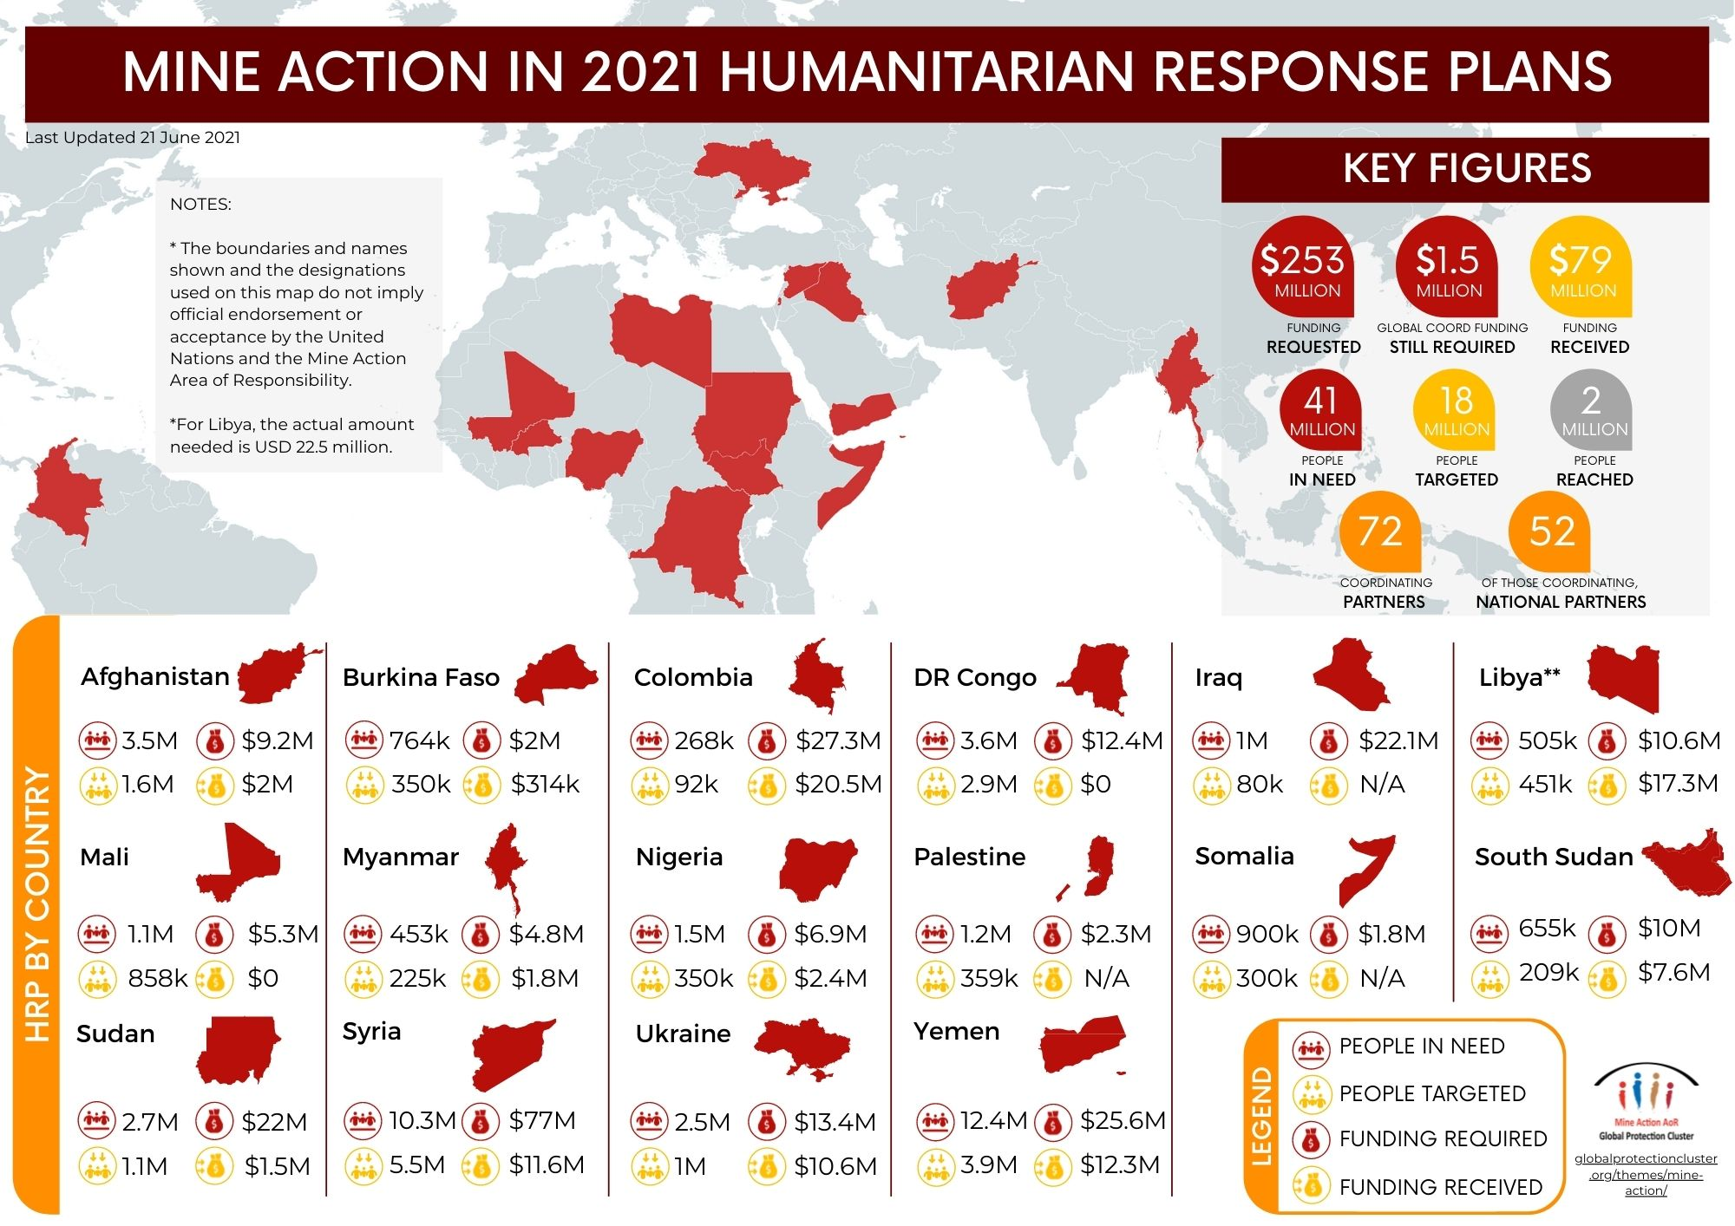

Slide 14
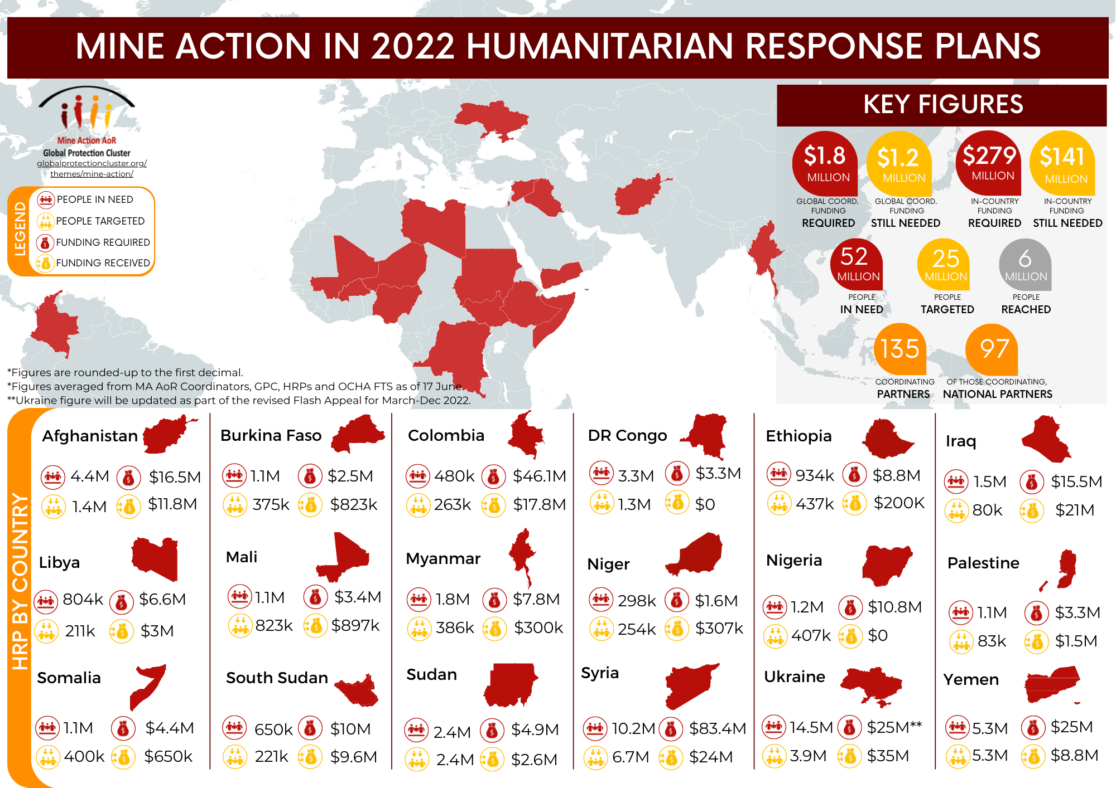

Slide 15
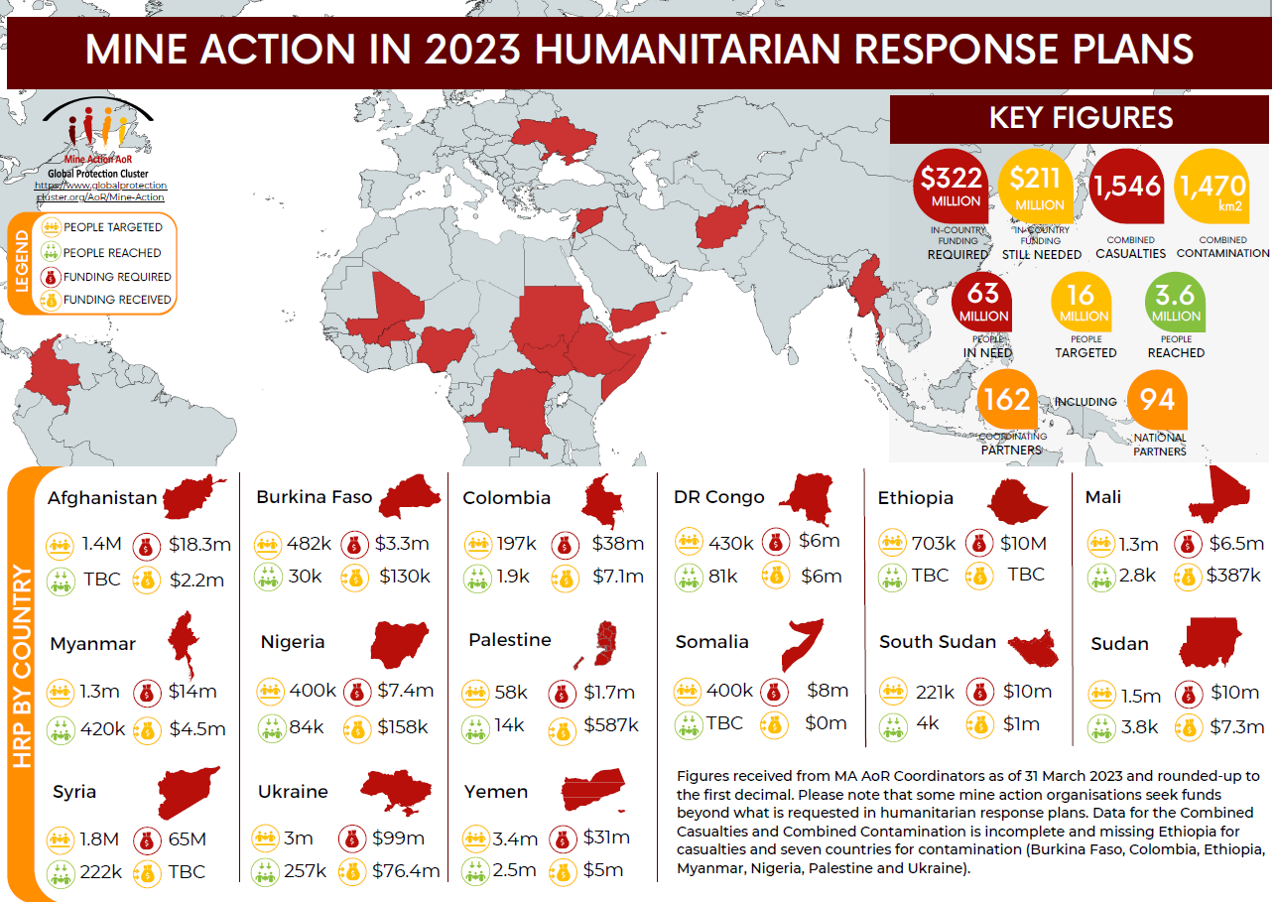

Slide 16
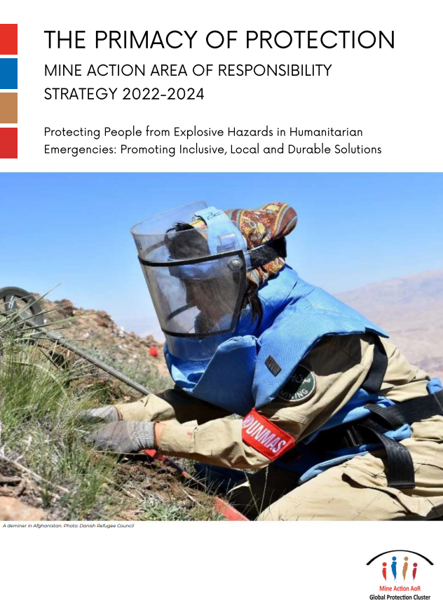

Slide 17
MA AoR Strategy
Vision: A world in which boys, girls, men and women living in humanitarian emergencies are protected from explosive hazards and where the rights of victims are recognized and respected.
Goals:
Offer reliable coordination for humanitarian mine action in emergencies to accelerate and deliver more impactful interventions.
Build and strengthen strategic partnerships.
Enhance and transfer capacity: strengthen the meaningful participation, representation and leadership of local and national actors in humanitarian coordination structures.
Promote equality, diversity and inclusion in operations and workforce.
Contribute to sustainable solutions in collaboration with peace and development actors.

Slide 18
