Slide 1
Human Rights Engagement in Practice
Session 2 – Human rights analysis

Slide 2
Ground rules for this webinar
The webinar will last for 2h
Participate – raise your hand, chat
Mute your microphone when you are not speaking
Share your comments, observations and questions

Slide 3
What this session about:
Discuss elements to include in a human rights analysis
How to use the Protection Analysis Framework (PAF) for human rights analysis
Conduct a simple case study of a human rights analysis based on the PAF

Slide 4
Human rights analysis
It is part of the human rights engagement process
Objectives of human rights analysis
What we analyze as part of a human rights analysis
What can the human rights analysis tell us
How can we use the human rights analysis

Slide 5
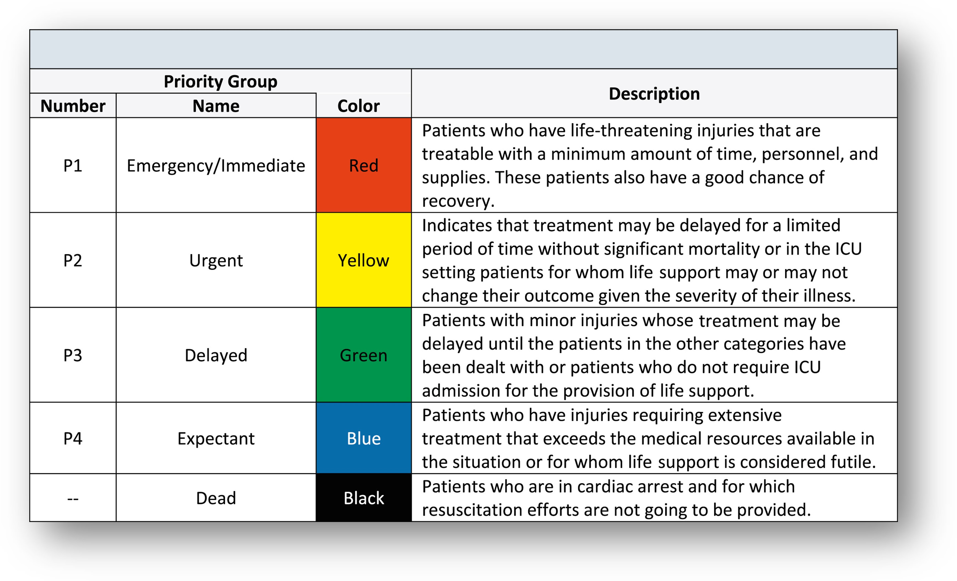
Protection Analysis tools: Severity Ranking
Severity Scale is not concept and tool created by humanitarian actors, but adapted by them.
Its origins are found in the medical ‘Triage’, the practice used to decide the order of treatment of a large number of patients or casualties.

Slide 6
What is a Protection Severity Ranking?
Protection Cluster use the severity scale as a measuring tool to identify and prioritize the geographical areas most affected by the crisis.
Is the key tool of the Protection Cluster and AoRs for accomplishing one of our core functions Clusters are responsible as for the Inter-Agency Standing Committee (IASC) decision:
Informing strategic decision-making of the HC/HCT for the humanitarian response through coordination of needs assessment, gap analysis and prioritization.

Slide 7
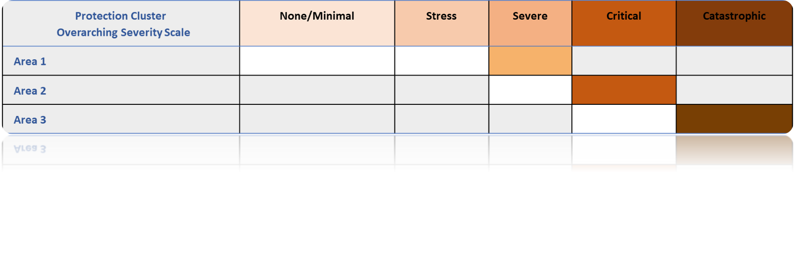
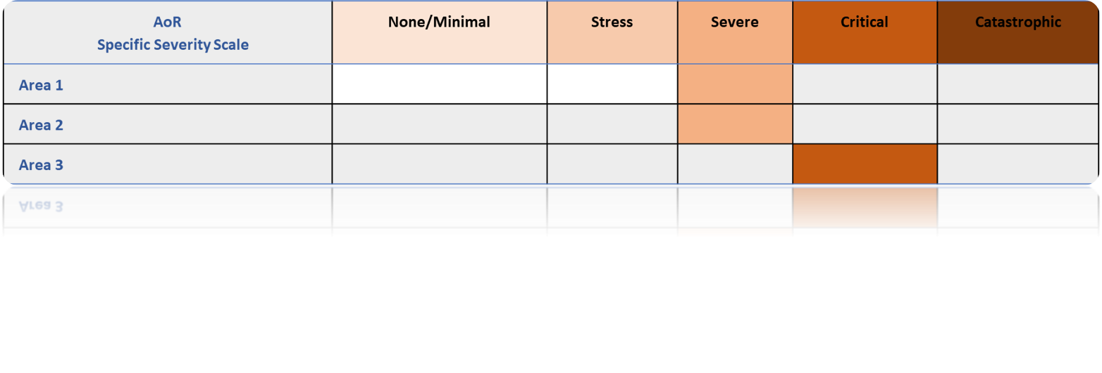
AoR specific Severity Scales can have either the same or lower scoring but not higher than the overarching Severity Scale scoring:
Example:

Slide 8
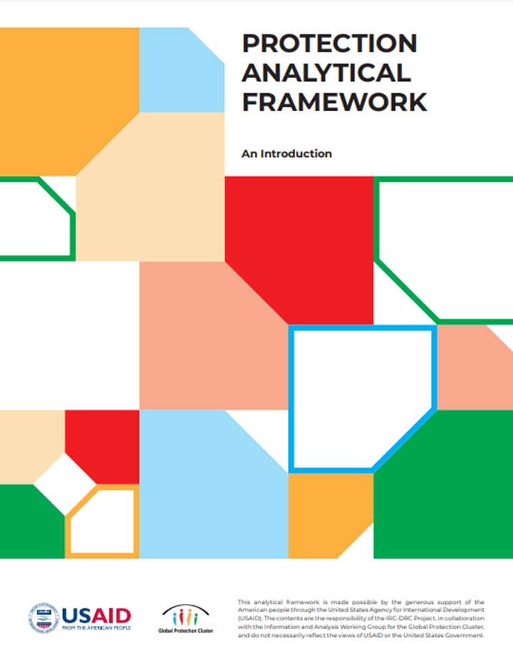
Protection analysis tools: Protection Analytical Framework
What we heard from the field?
“What is a protection risk? If it’s still a vague term, then people come with different kinds of answers and analysis. We need a shared understanding.”
“We already have been doing a lot of data collection, we have a lot of information. We just need help in making a structured analysis.“

Slide 9
Goals for our
protection
analysis
Representative and collaborative
Common terminology / language accessible for all
Continuous & iterative process
Helps navigate complexity
Action-oriented , timely, measured

Slide 10
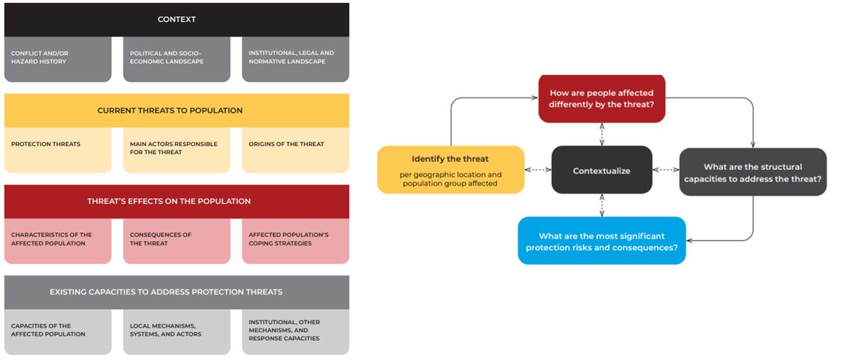
The PAF Structure and Core Logic

Slide 11
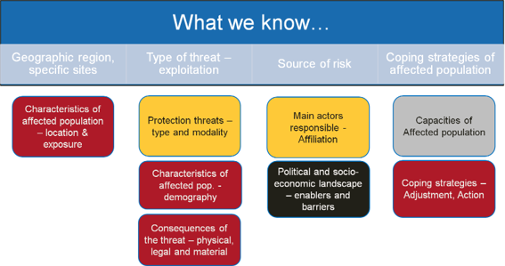
Putting the PAF into Practice
In our recent assessment, we discovered…
Exploitation due to lack of civil status documentation

Slide 12
In our protection assessment, we discovered…
Recruitment of children by a non-State armed group.

Slide 13
Debriefing from group exercise:
Question 1: What protection risks can you identify? What human rights violations can you identify and describe?
Question 2: What human rights norms and instruments could you use to address some of those protection risks?
Question 3: What recommendations would you suggest to the Humanitarian actors to remedy those human rights violations?

Slide 14
Key messages from today’s learning session
It is important to pay attention to the frame used for the analysis of protection risks.
Human rights analysis is an integral part of engagement with the human rights mechanisms.
A comprehensive human rights analysis requires input collected directly from IDPs on their enjoyment of human rights as well as from other actors.
States have the primary responsibility to realize human rights and address human rights violations.

Slide 15
Thank you for your attention!
Session 2 – Human rights analysis

